Slide 1

Research papers with CLAs: Visualizing data
Patrick Montjourides, Nairobi, March 2018

Slide 2
The world is generating data at an exponential speed
35 ZETTABYTES
1 ZETTABYTE=
1 EXABYTE=
1
800 EXABYTES
0
0
0
0
0
0
0
0
0
0
0
0
0
0
0
0
0
0
0
0
0
5 EXABYTES
Early years of humanity to 2003
2010
Projected (2020)

Slide 3
Education data and the
importance of visualization
Education data are a minor part of the global flow of information
But education is an important piece of national and global development
Data in education need to get some greater visibility
People’s available time is shrinking, people’s focus is diminishing
Adequate data vizualisation can improve message communication, arguments enforcement and purpose illustration
Inapropriate data vizualisation can get people confused and make them running away from looking at your work and consequently hinder the diffusion of important messages

Slide 4
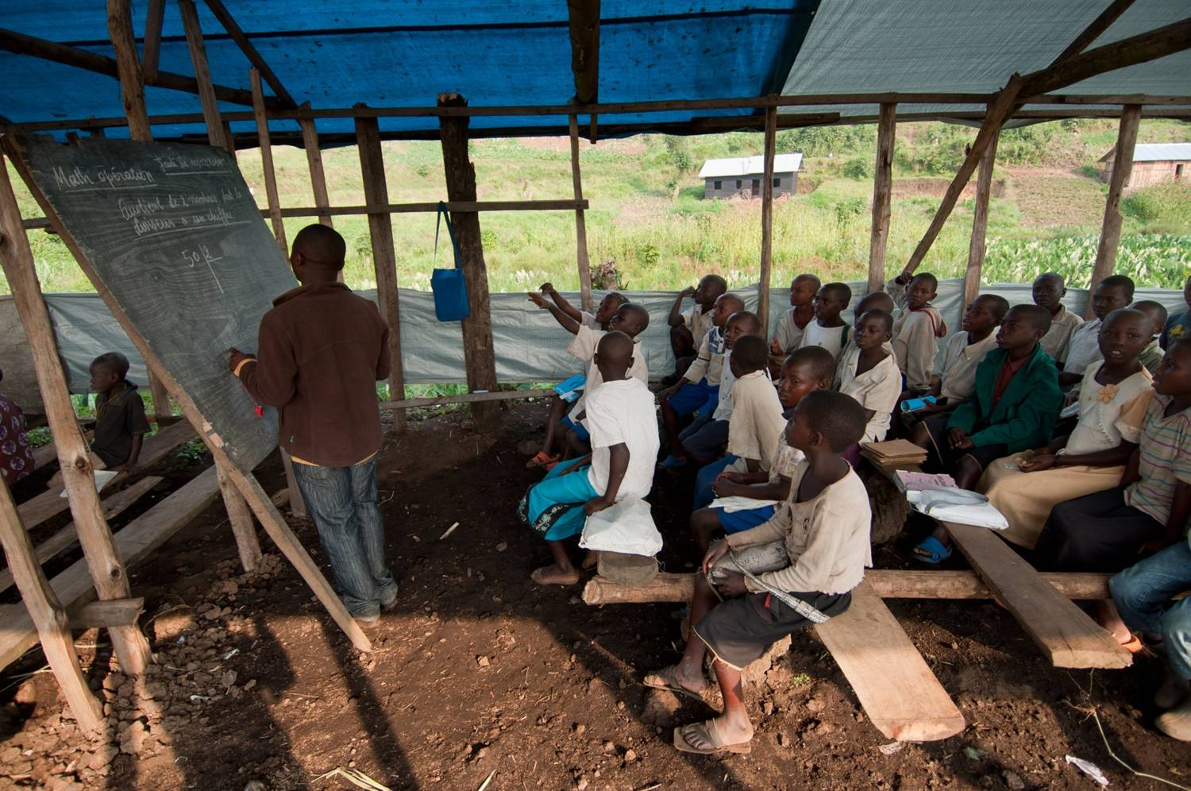
1
0
1
1
0
1
0
0
1
0
1
0
1
1
0
1
0
0
1
0
1
0
1
1
0
1
0
0
1
0
1
0
1
1
0
1
0
0
1
0
1
0
1
1
0
1
0
0
1
0
1
0
1
1
0
1
0
0
1
0
1
0
1
1
0
1
0
0
1
0
1
0
1
1
0
1
0
0
1
0
1
0
1
1
0
1
0
0
1
0
1
0
1
1
0
1
0
0
1
0
1
0
1
1
0
1
0
0
1
0
1
0
1
1
0
1
0
0
1
0
1
0
1
1
0
1
0
0
1
0
1
0
1
1
0
1
0
0
1
0
1
0
1
1
0
1
0
0
1
0
1
0
1
1
0
1
0
0
1
0
1
0
1
1
0
1
0
0
1
0
1
0
1
1
0
1
0
0
0
1
1
0
1
1
0
1
0
0
1
0
1
0
1
1
0
1
0
0
0
0
1
0
1
1
0
1
0
0
1
0
1
0
1
1
0
1
0
0
0
0
1
0
1
1
0
1
0
0
0
1
1
0
1
1
0
1
0
0
1
0
1
0
1
1
0
1
0
0
0
0
1
0
1
1
0
1
0
0
0
0
1
0
1
1
0
1
0
0
1
0
1
0
1
1
0
1
0
0
1
0
1
0
1
1
0
1
0
0
1
0
1
0
1
1
0
1
0
0
1
1
1
0
1
1
0
1
0
0
1
0
1
0
1
1
0
1
0
0
1
1
1
0
1
1
0
1
0
0
1
0
1
0
1
1
0
1
0
0
1
0
1
0
1
1
0
1
0
0
1
1
1
0
1
1
0
1
0
0
1
1
The researcher …
…often struggles to depict the reality

Slide 5
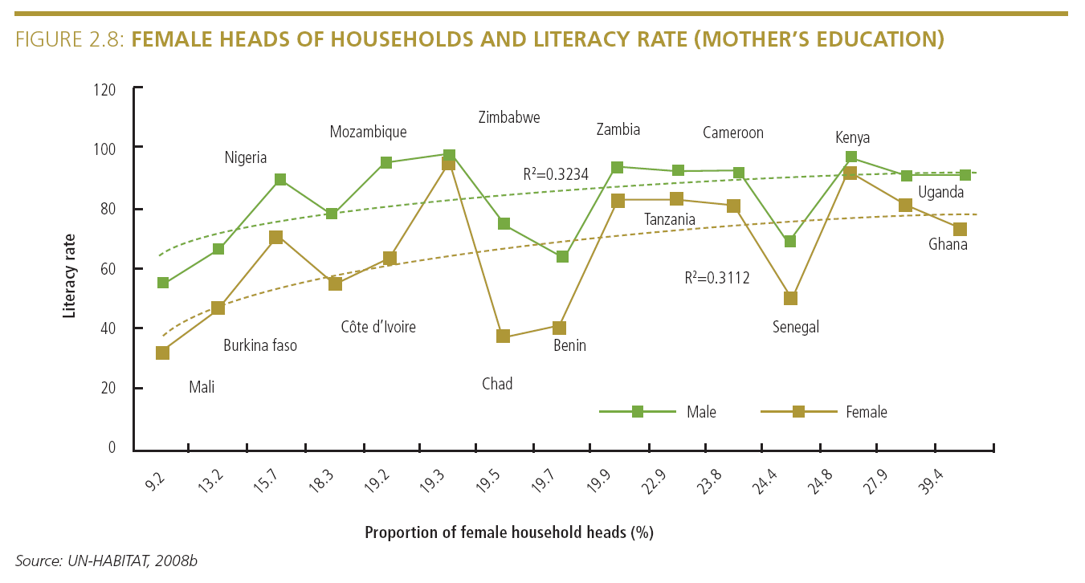
Sometimes, even very simple messages don’t get across because the visualization wasn’t good
“Mother’s education promotes child literacy
This suggests a strong relationship between girls’ primary
education and mother’s education in urban areas.”

Slide 6
Data visualization can…
… uncover patterns in large data
… make people get a point faster
… tell stories, yet be shared easily
Use of data visualization to:
Summarize findings accurately
Facilitate online dissemination
Increase non-expert communication
Create a platform for advocacy

Slide 7
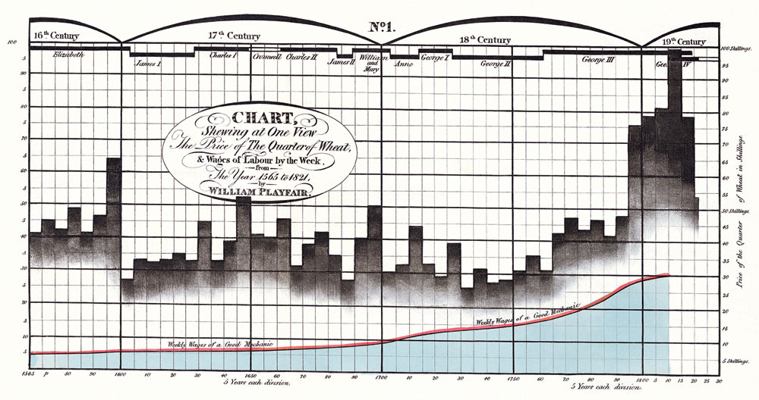
What is data vizualisation?

Slide 8
A definition:
“Data graphics visually display measured quantities by means of the combined use of points, lines, a coordinate system, numbers, symbols, words, shading, and color.”
E. Tufte
Data visualization ≠ Infographics

Slide 9

John Snow’s map of Cholera outbreak in London
Each stripe signifies a death
1854

Slide 10


Slide 11
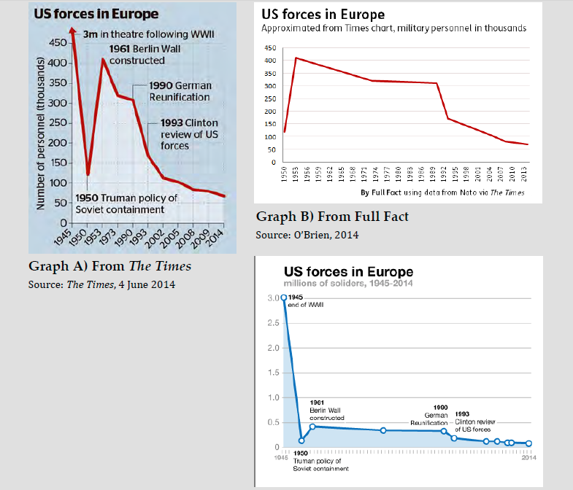
Data visualization and reliability…

Slide 12
DATA VISUALIZATION PRINCIPLES, A SURVIVAL KIT

Slide 13
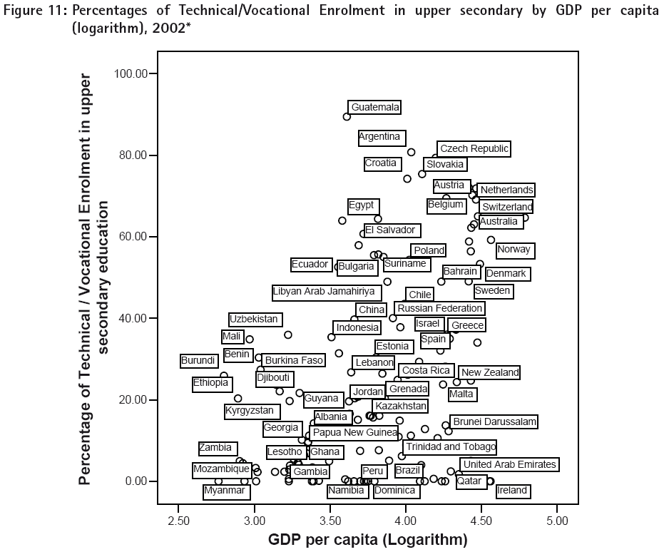
The assumption that creating good charts (and tables) is easy and natural, not needing much study is wrong

Slide 14
Some principles
Education data visualization in research or national and international reports has to be grounded in existing…research.
Visual perception, memory, differentiation, grouping all important dimensions have been theorized and some important results have emerged
The most important is the aim of the chart, not the chart itself - sometimes a table or a sentence is much better

Slide 15
Importance of the human brain
Our capacity to make visual observations rapidly and easily is based on the brain's ability to perceive regularities and irregularities. Much of this ability works unconsciously. The comparison is done almost before we start to think about it.

Slide 16
Importance of the human brain

Slide 17
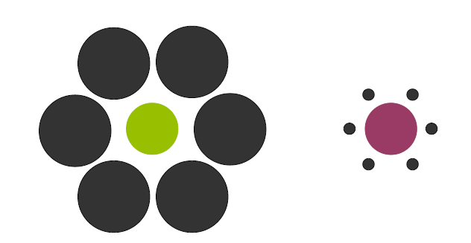
Importance of the human brain

Slide 18
Preattentive variables

Slide 19
Preattentive variables

Slide 20
Preattentive variables

Slide 21
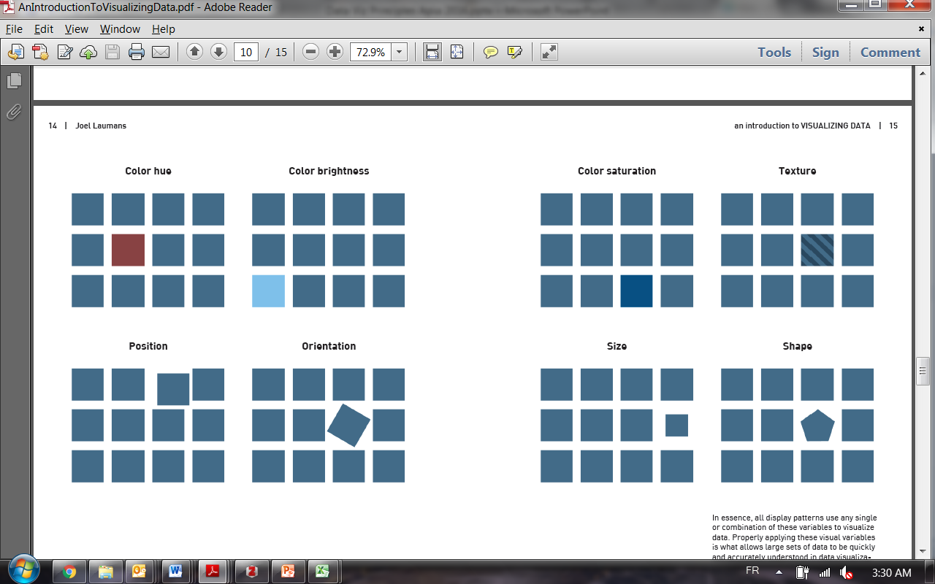
Preattentive variables

Slide 22
Avoid the ‘visual shock’

Slide 23
Reduce the data-Ink ratio
DATA-INK Ratio : Data - ink
Total amount of ink used for the chart

Slide 24
Reduce the data-Ink ratio

Slide 25
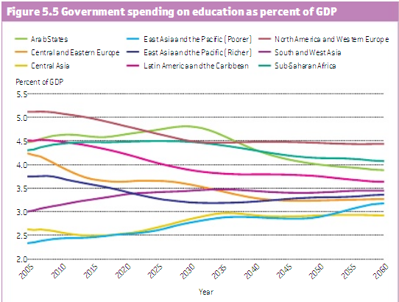
Limits of the memory are to be taken into account

Slide 26
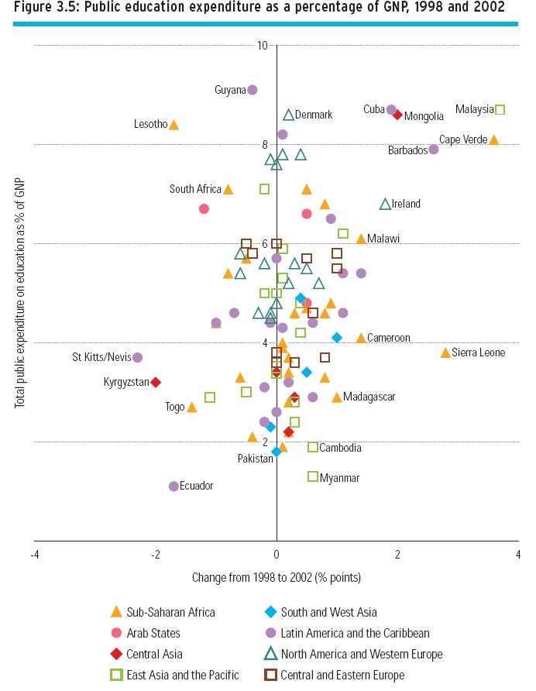
Do you need to duplicate information?
Too much variations
anihilate differentiation

Slide 27
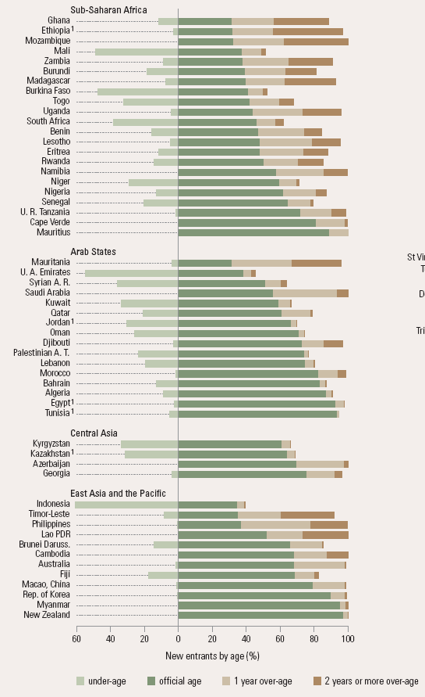
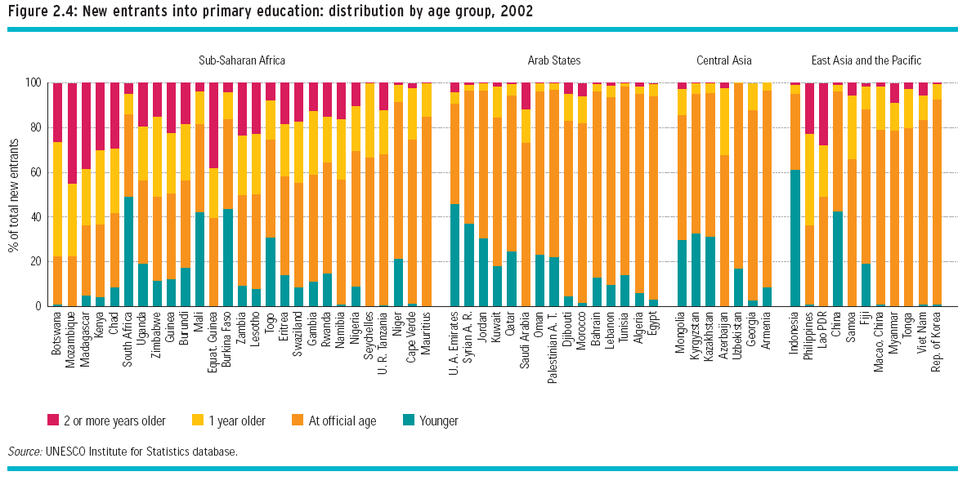
Some types of chart have to be used carefully
Stacked bar charts only allow for good
comparison of the bottom two categories
Pie charts are among the less readable
when it comes to make comparison for
more than two slices
3D charts are to be avoided as well

Slide 28
Some simple things
can greatly improve
the readibility of
your charts

Slide 29
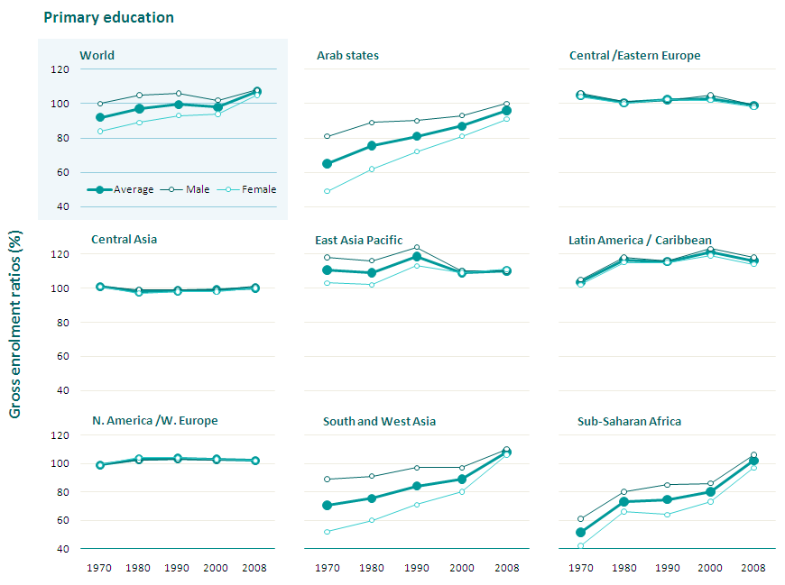
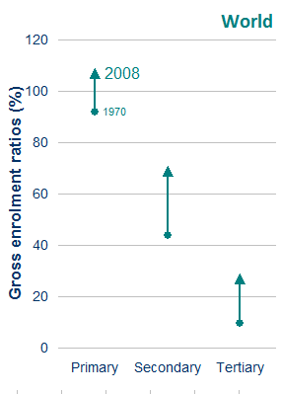
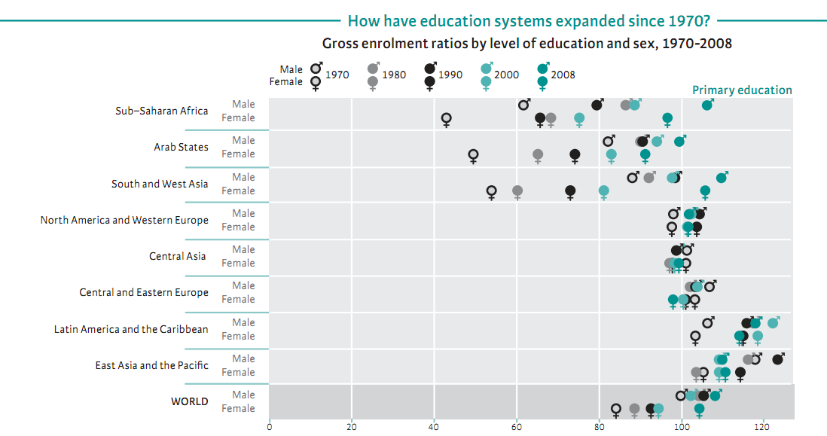
All these rules can significantly improve the readibility
and thus help you get the message accros

Slide 30
Tables are also data visualizations

Slide 31
Before doing a data visualization:
Data visualization is only one skill of the data scientist
1- Clean the data (requires good data processing,
data quality control and data validation)
2- Mine and analyze the data to identify your message.
A chart is often best when the message is clear and
known. Avoid doing a chart for the sake of it.
3- Identify the type of data and the relationship to
Help you decide on the type of representation

Slide 32
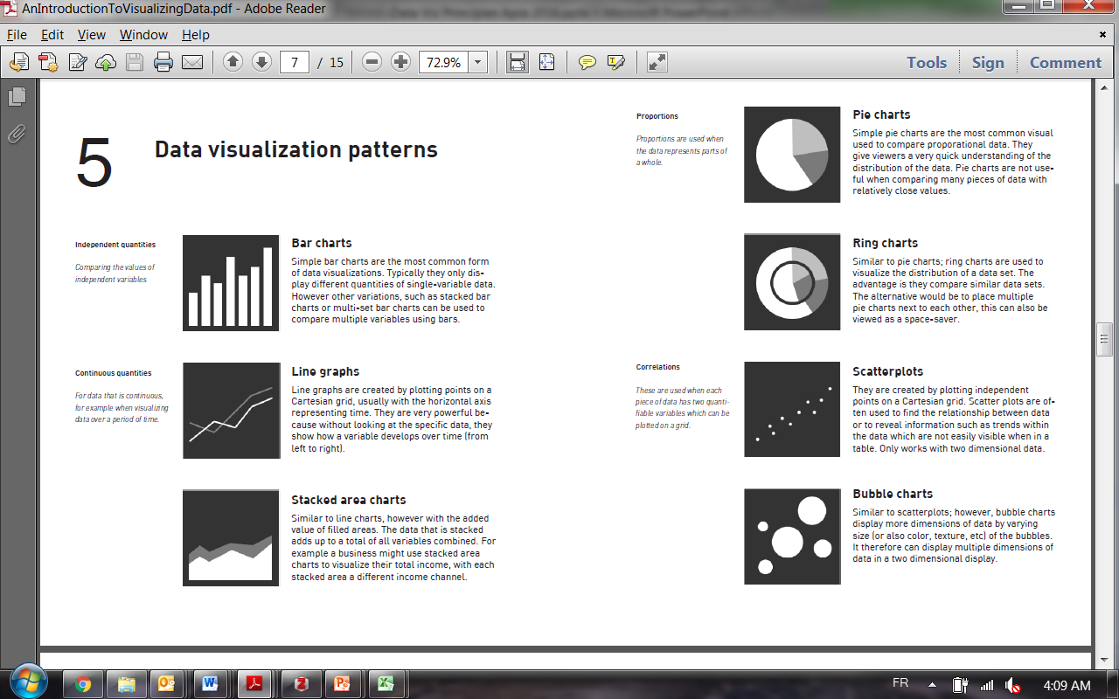

Slide 34
You can do a lot with everyday tools

Slide 35
ANIMATION Headache
NEW!!
Introduction
Basics
Animating excel charts
Advanced animations

Slide 36
Excel charts
Customize native charts and create your own charts
Excel can do pretty much everything
Power point animations
Animate excel charts
…to support your narration

Slide 37
Education marginalization – inequalities within countries
The case of Nigeria
14
Ukraine
12
Cuba
10 years
10.3 years
9.7 years
Rural
Rich, rural boys
10
Richest 20%
Rich, urban boys
Bolivia
Urban
Rich, rural girls
Indonesia
Boys
8
Girls
Average number of years of schooling
Honduras
Nigeria
Urban
6.7 years
Cameroon
6.4 years
Poor, urban boys
6
Bangladesh
4
Education poverty
Poorest 20%
3.5 years
Rural
Chad
3.3 years
Poor, rural girls
2
2.6 years
Extreme education poverty
0
C. A. R.
Rural Hausa
Poor, rural Hausa girls
0.5 years
0.3 years

Slide 38
Inequalities based on wealth in primary attainment
Net attendance rate and primary attainment among the poorest and the richest 20%
Average
Poorest 20%
Richest 20%
Madagascar
Indonesia
100
Haiti
Nicaragua
Rwanda
Malawi
Indonesia
Bangladesh
Nigeria
90
Rwanda
Mozambique
Benin
India
Madagascar
Haiti
Bangladesh
Indonesia
Malawi
Niger
Nicaragua
Ethiopia
80
Rwanda
Bangladesh
India
Ghana
Malawi
Burkina Faso
Nigeria
70
Richest 20%
Mozambique
Benin
India
Poorest 20%
60
Madagascar
Ghana
Net attendance rate in primary education (%)
Haiti
Nicaragua
50
Niger
Mozambique
Benin
Ethiopia
Nigeria
40
Burkina Faso
Ghana
30
Niger
Ethiopia
20
Burkina Faso
10
0
0
10
20
30
40
50
60
70
80
90
100
Primary education attainment for age group 17-22 (%)

Slide 39


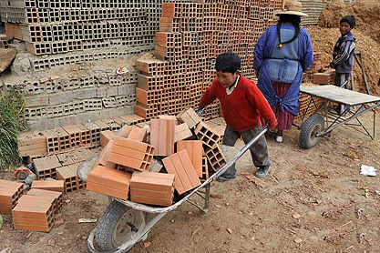
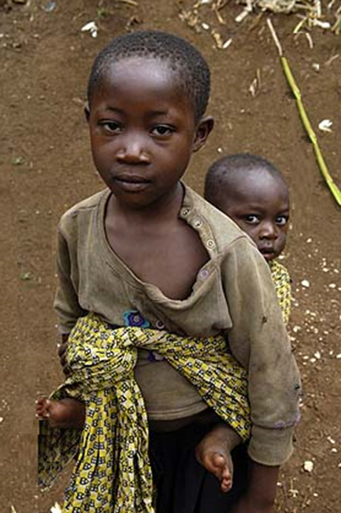


























































































































































































Left behind: out of school children and youth, the challenge ahead
Gender
Disability
Conflict
Remoteness
Child Labor
Ethnicity
Poverty
Language
Early Marriage
Orphanhood
Forced displacement

